Slide 1


MIU FOODIE FINDER.
Presented To : Dr. Eman El Ayat .

Slide 2
Introducing Ourselves
Bahig Mahmoud Samir
Mina Adel Adly
Mina Atef Marzouk
Omar sherif Saeed
Ahmed Osama Salah
Yousif Ahmed Mohamed

Slide 3
Agenda
Survey
Customer Value
Product/Service Scope
VRIO
Value Chain Analysis
Value Proposition
PESTEL
Business Model Canvas
SWOT
Business Model Process
Porter's 5 Forces
Business Process Model-Revisited
Future Decision Making
Final Analysis

Slide 4
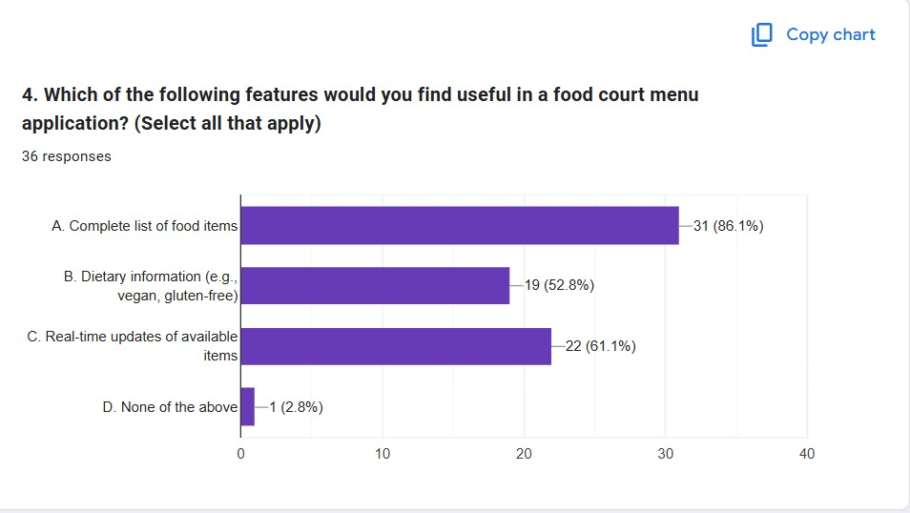
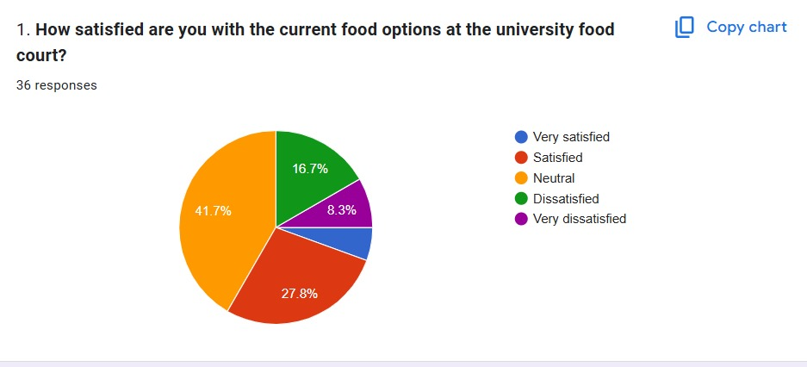
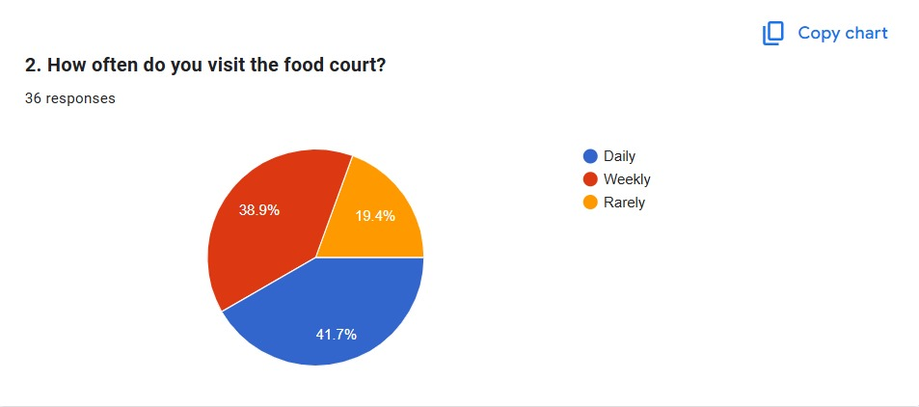
Survey

Slide 5
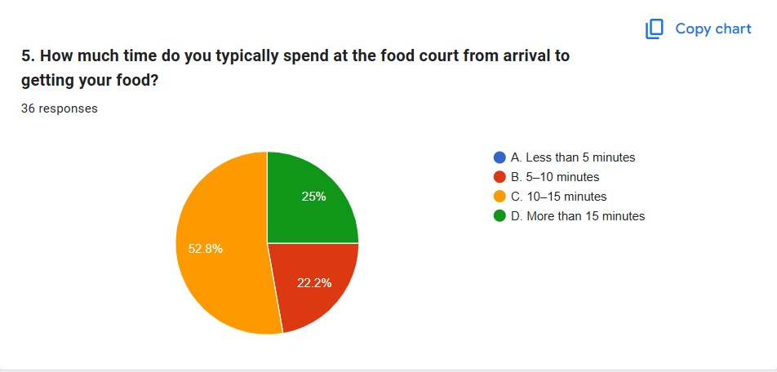
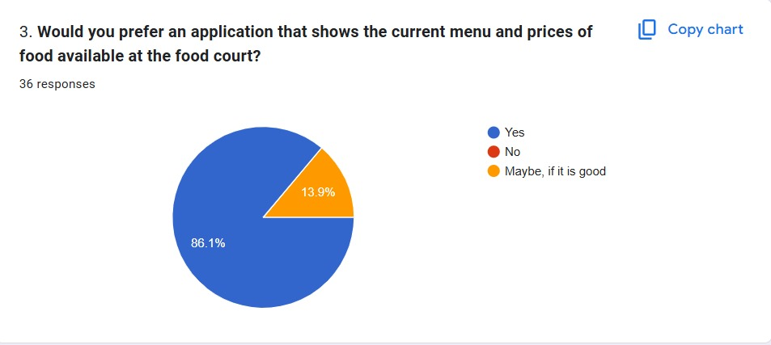
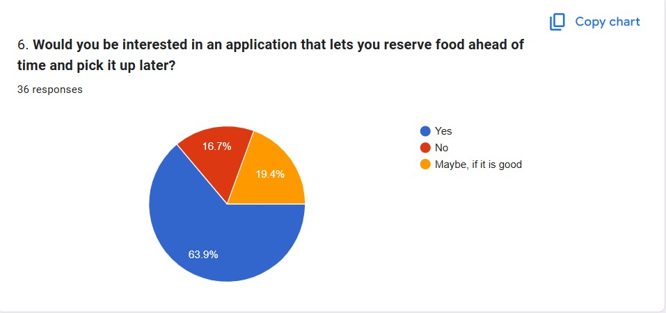

Slide 6
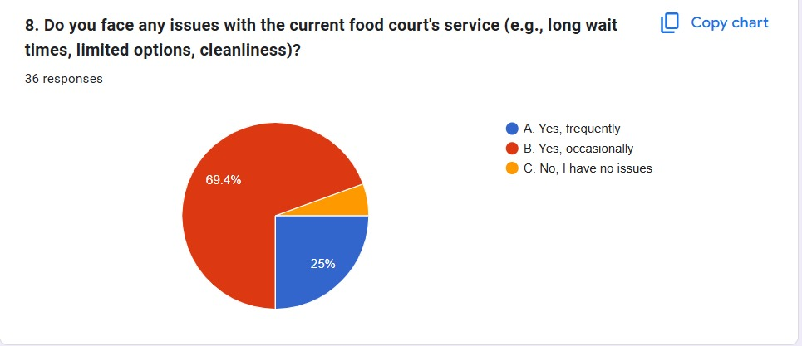
Problem Definition
We have already done the survey. We found out there is a problem that students need one menu that collects all menus. As we found out in the survey, students voted that they face long wait times and limited options answered majority (yes, frequently).The survey shows more than 50 percent need to pick up method and delivery as the most waits around 15 min.

Slide 7
Customer Value
Runtime menus, Search & filter and Comparison, Pick up and online delivery

Slide 8
Product and Service Scope
Digital Menu Access Students can view detailed vendor menus directly from their phones, including item descriptions, pricing, and top deals(Top Seller).
Customizable Search Users can search for food options tailored to their preferences, such as dietary restrictions, cuisine type, or budget.
Multiple Payment Methods Payment flexibility includes options like InstaPay, cash on pickup and delivery, and credit card payments.

Slide 9
Product Updates Real-time notifications inform students about item availability or sold-out products
Dashboards
Student Dashboard: Browse menus, filter meals, track orders, write reviews, and report issues.
Vendor Dashboard: Manage menus, update prices, and track orders.
Owner Dashboard: Monitor vendor and student activities, review feedback, and block students for unreceived orders.

Slide 10
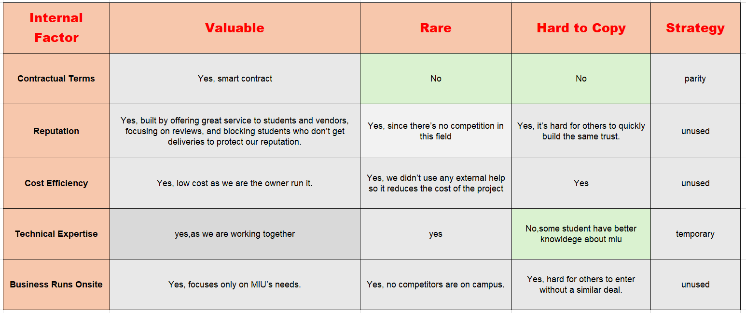
VRIO

Slide 11
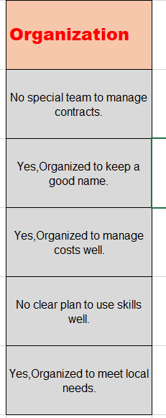
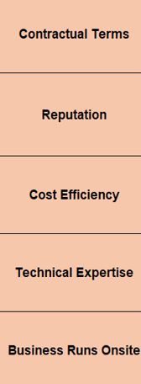
Long Term Competitive Strategy

Slide 12
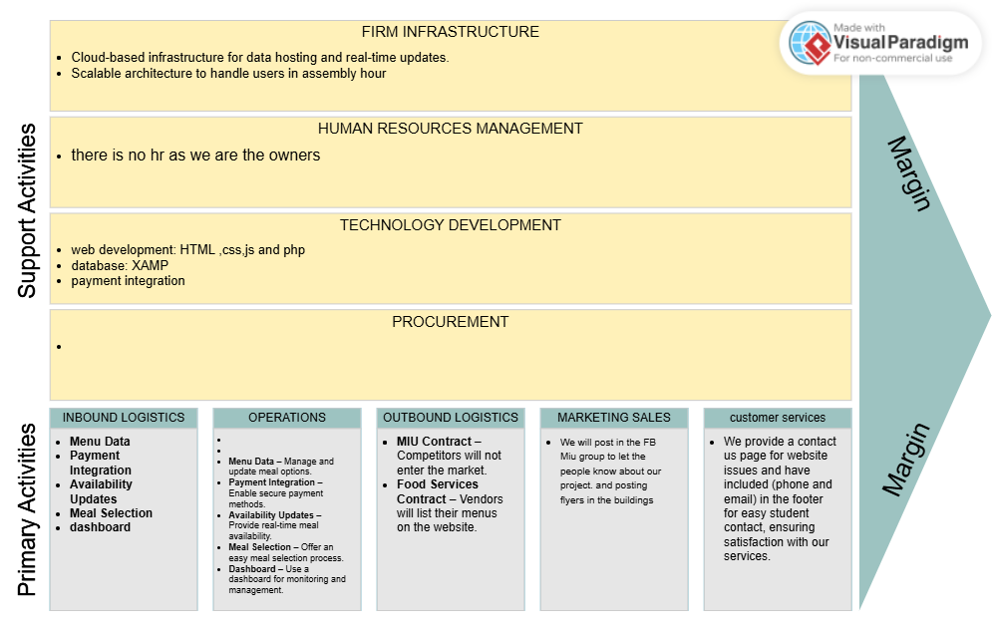
Value Chain Analysis Internal Analysis

Slide 13
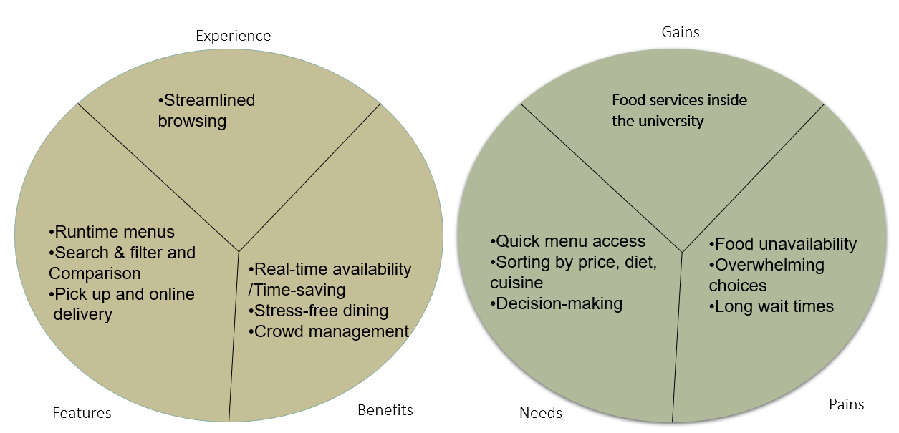
Value Proposition

Slide 14
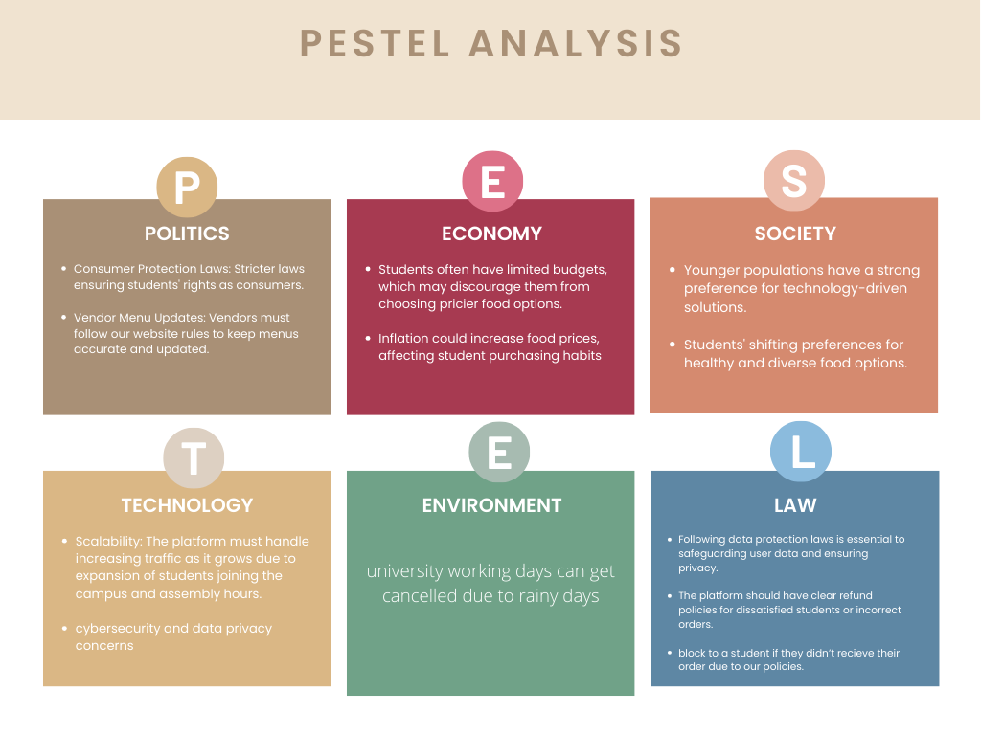
PESTEL
Macro Analysis

Slide 15
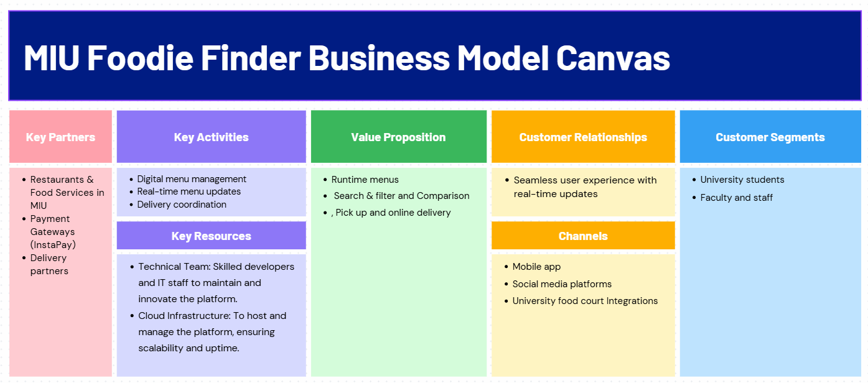
Business Model Canvas

Slide 16
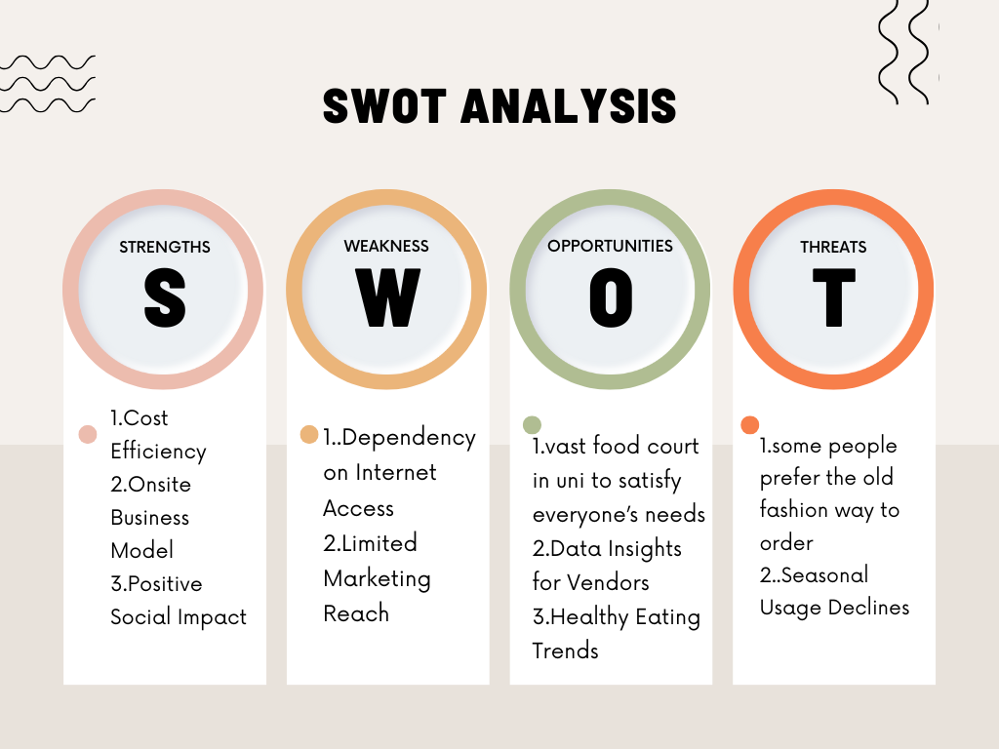
SWOT

Slide 17
Business Model Process

Slide 18
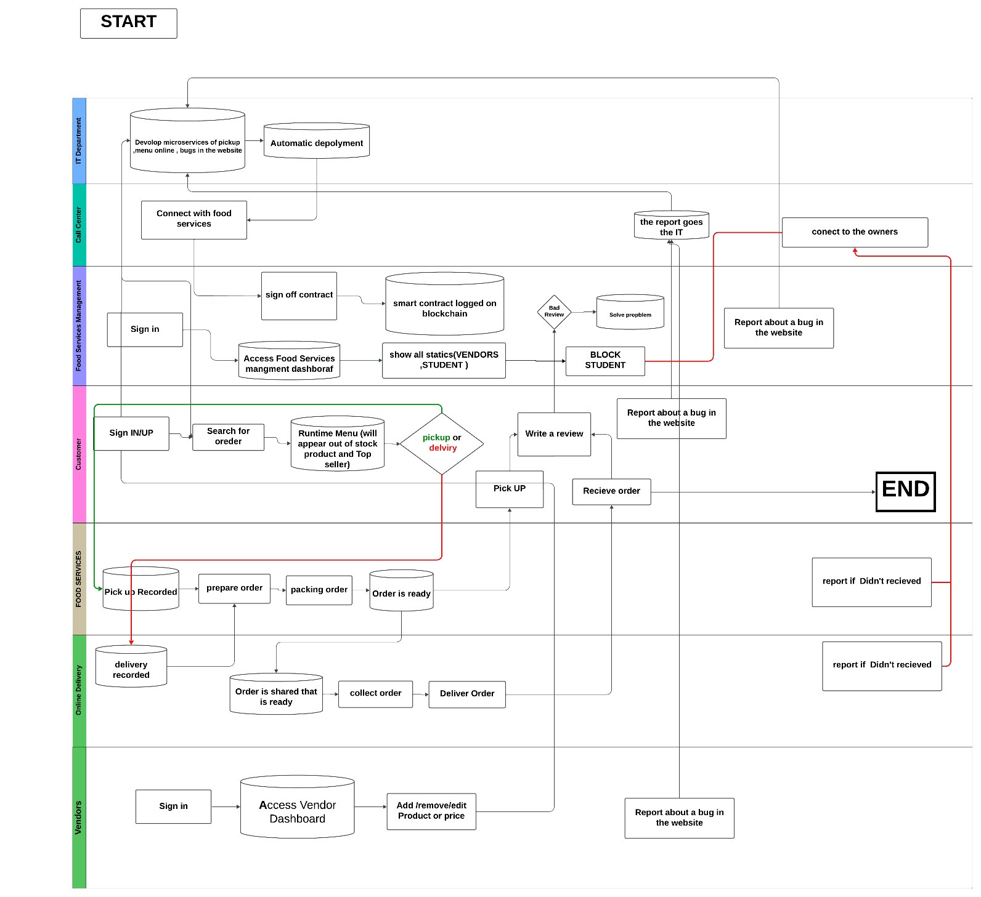

Slide 19
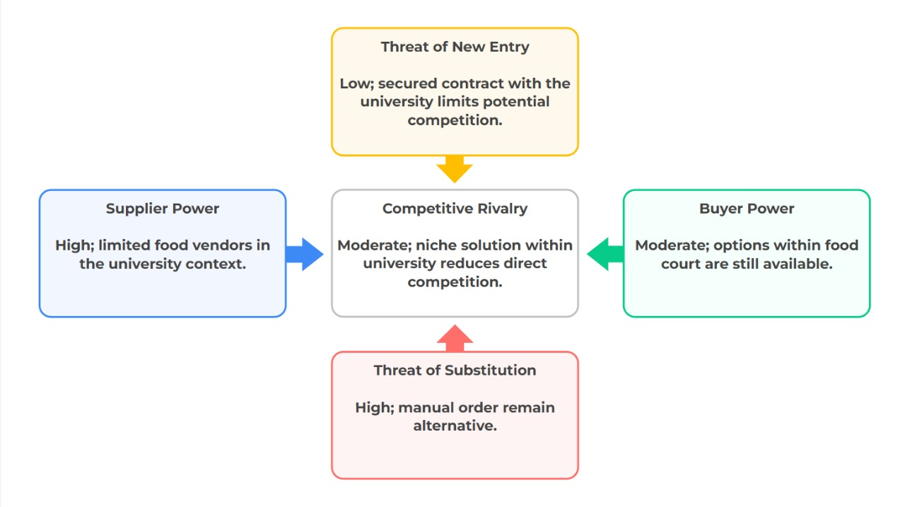
Porter's 5 Forces

Slide 20
Business Process Model-Revisited

Slide 21
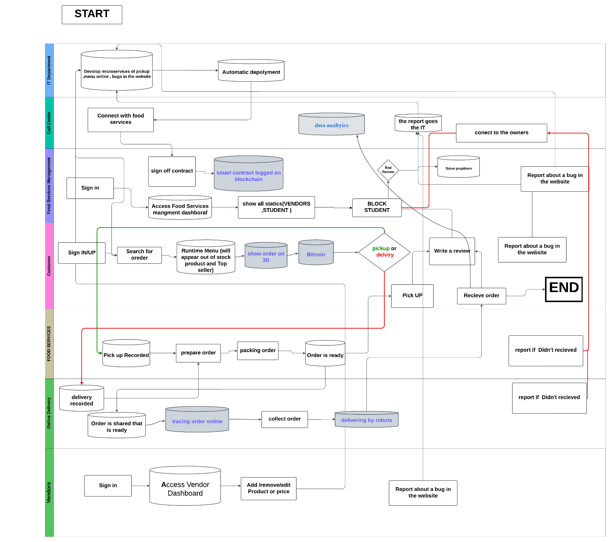

Slide 22
Future Decision Making

Slide 23
Digital Transformation Strategy Decision Making
Digital Business Channel Priorities
Because we have a website and provide delivery services, we use a digital approach. Customers can order food online, view updated menus, and have their meals delivered promptly through this, which helps us make things easier for them. Additionally, it enhances the MIU staff and student experience in general.
SWOT Strategy:
So Strategy(Strengths-Opportunities)
We help student to choose their meal easily (Positive impact )
Work with the university and vendors to improve the food court experience.

Slide 24
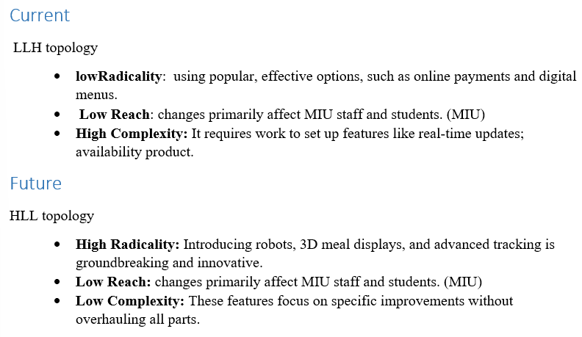
BMI Typology
Protector(defender)
player(defender)

Slide 25
Final Analysis
1-Firstly, students take a long time waiting for their orders due to long queues of students that want to see the menu to decide what to get; as a result, they tend to waste a lot of time and be late for the lecture. Furthermore, most students waiting in the queue afterward found out their order was out of stock, or there was a problem with the payment ;they don't accept online payment.

Slide 26
Final Analysis
2-We have already done the survey. We found out there is a problem that students need one menu that collects all menus. As we found out in the survey, students voted that they face long wait times and limited options answered majority (yes, frequently). The survey shows more than 50 percent need to pick up method and delivery as the most waits around 15 min.

Slide 27
Final Analysis
3-By putting in place a digital menu management system with real-time updates and a delivery coordinator, as well as a simplified food selection process with filters and multiple payment options (InstaPay, credit card, and COD), as well as pickup and delivery services through partners, we are resolving the issue and lowering stress and waiting times while enabling every student to find a meal that suits their needs. MIU's restaurant and food services are focusing on the student and staff customer segments to make sure the system runs easily and exceeds goals.

Slide 28
Final Analysis
We enhanced our project so that we use robots instead of office boys, and we added a new feature to show the meal in 3D. and we use data analytics and tracking orders online.

Slide 29
Website

Slide 30
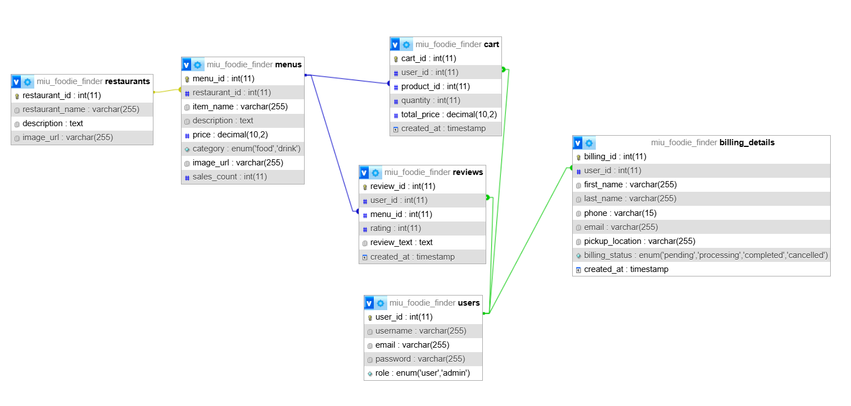
Website

Slide 31
Thank you

